Slide 1


CTM2030 Leaders’ Network - January 2024
Ein Hiechyd
Ein Dyfodol
DATBLYGU CYMUNEDAU
IACHACH GYDA’N GILYDD
Introducing Cwm Taf Morgannwg’s Alcohol Care Service: taking a person centred approach to delivery
Dr Dai Samuel – Consultant Hepatologist / Clinical Lead, CTM UHB
Mr Kyle Newton – Alcohol Care Team Lead, CTM UHB
Mrs Marie Evans – Head Of Planning & Commissioning, CTM UHB
Mrs Dee Lowry, Head of VBHC, CTM UHB
Notes:
Opening Slide

Slide 2
Alcohol in Wales: A snapshot
In 2018-19, the average annual consumption of all drinkers was 532 units. This varied from 221 units for moderate drinkers to 3,973 units for harmful drinkers. The 18% of adults who were hazardous or harmful drinkers consumed 68% of all alcohol drunk by Welsh adults. The 2% who were harmful drinkers consumed 23%
Wales has one of the most serious problems of drinking amongst young people below the legal age to purchase alcohol, with 54 per cent of 15 year old boys in Wales and 52 per cent of girls of that age saying they have been drunk at least twice.
Alcohol consumption has increased significantly during the pandemic and has resulted an increase in obvious alcohol related presentations such as cirrhosis and Cancer, but also less obvious alcohol related presentations
A large proportion of “frequent attenders” have alcohol (and other substance) dependency, and this often drives their ongoing behaviours and reasons for attendance

Slide 3
Current service models
Rhondda Taf Ely and Merthyr and Cynon Localities:
Monday-Friday (9-5) - secondary care, including the Emergency Department, and satellite hospitals
X1 WTE Band 6 which covers PCH and YCC
X1 WTE Band 6 covering RGH and YCR.
Bridgend Locality:
Substance Misuse Liaison service consists
    Band 6 nurse (2 x 18 ¾ hours) covering Princess of Wales Hospital, 7 days a week 07.00-21.00.
Third Sector involvement
Service Delivery – Tiers 1 and 2 interventions are provided by;
    Barod
    Dyfodol Criminal Justice Services

Slide 4

Person Centred Value-Based Healthcare Approach
VBHC funding allocations to each Health Board and NHS Trust, as well as an additional National pot for areas of work which will support driving best practice across Wales
CTMUHB are participants in the NHS Wales and Global project on Person Centred Care – our Alcohol Care Team Project
Taking whole systems, digitally enabled approaches to patient pathways, in partnership with service users and citizens, partners and suppliers.
Personal Value: ensuring that each individual patient´s values are used as a basis for decision-making in a way that will optimise the benefits for them.
Technical Value: ensuring that the allocated resources are used optimally (no waste).
Allocative Value: ensuring that all available resources are taken into account and distributed in an equitable fashion.
Societal Value: ensuring that the intervention in healthcare contributes to connectedness, social cohesion, solidarity, mutual respect, openness to diversity, wellness, wellbeing and flourishing. It also includes wider determinants of health, wellness and wellbeing including environmental impact, energy and waste management, implications for circular economy and creating vibrant and resilient communities.

Slide 5
Bid approval – future service model
Vision : To develop and provide 7 day a week patient-centred support for patients with alcohol related problems, in ways and places which meet the needs of the patients and families accessing them, in partnership with patients, families and other partner organisations.
X2 WTE Band 6 nurses and a Band 4 Assistant Alcohol Practitioners on each DGH site
Band 7 Clinical Lead/Manager
VBHC Team support
Band 4 Admin support

Slide 6
Intended Improvements/Measurable Outcomes
 | Short and Longer Term
 | Short Term | Longer Term
Development of 7 Day Alcohol Care Service. | A shift from a 5 to 7 day service. Reduced numbers of alcohol related admissions and re-admissions Reduce lengths of stay Reduce number of patients recorded as alcohol related cirrhosis. Reduce “frequent flyers” through Alcohol Liaison Intervention in A & E. Improve the number of patients receiving interventions and care due to the ALS being available 7 days a week Increase early identification and intervention to individuals to reduce the harms caused from alcohol misuse. Increase referrals to community support services & community substance misuse service within the community to promote ongoing recovery. | Meet the projected increase in demand placed on services Reduction in demand placed on liver disease services Reduction in harmful, hazardous drinkers within the CTM population To improve outcomes for patients with alcohol related problems Reduce the number of alcohol related death and liver disease mortality Impact on societal value associated with alcohol misuse e.g. family breakdowns, domestic violence. Reduce disease risk due to key lifestyle behaviours. Reduction in alcohol related brain injuries, patients often require long hospital stays, complex discharges involving packages of care and some times a referral to a specialist unit. Reduction in peri alcohol exposure & foetal alcohol syndrome and the ongoing, often complex impact on individuals and the services accessed throughout their lives. The SIGN guideline states “Prevalence of FASD in the UK rising to 32.4 per 1,000 (95% CI 20.0 to 49.0) making neurodevelopmental disorder related to PAE one of the commonest preventable causes of impairment”. 32.4/ 1000 is 3.24%.

Slide 7
What have we done so far ?
Service User Involvement
Engaging with Service User Group – Working jointly with the Area Planning Board and the third sector i.e. Barod, a focus group session was held on 15th February 2023 to engage, listen and learn, with service users on the both the existing alcohol care service provided as well as seeking their views on the expansion to a 7 day service.
Further work included: Co-production of a A&E questionnaire, a patient leaflet and members were part of our recruitment process.
Creative Facilitators were part of this work who have used the feedback to write and record a spoken word song. Bridge the Gap YouTube link https://youtu.be/d88UEJlD8Xo

Slide 8


Insights from Our Service Users
Interview 2
Interview 1, Chair of SIG

Slide 9
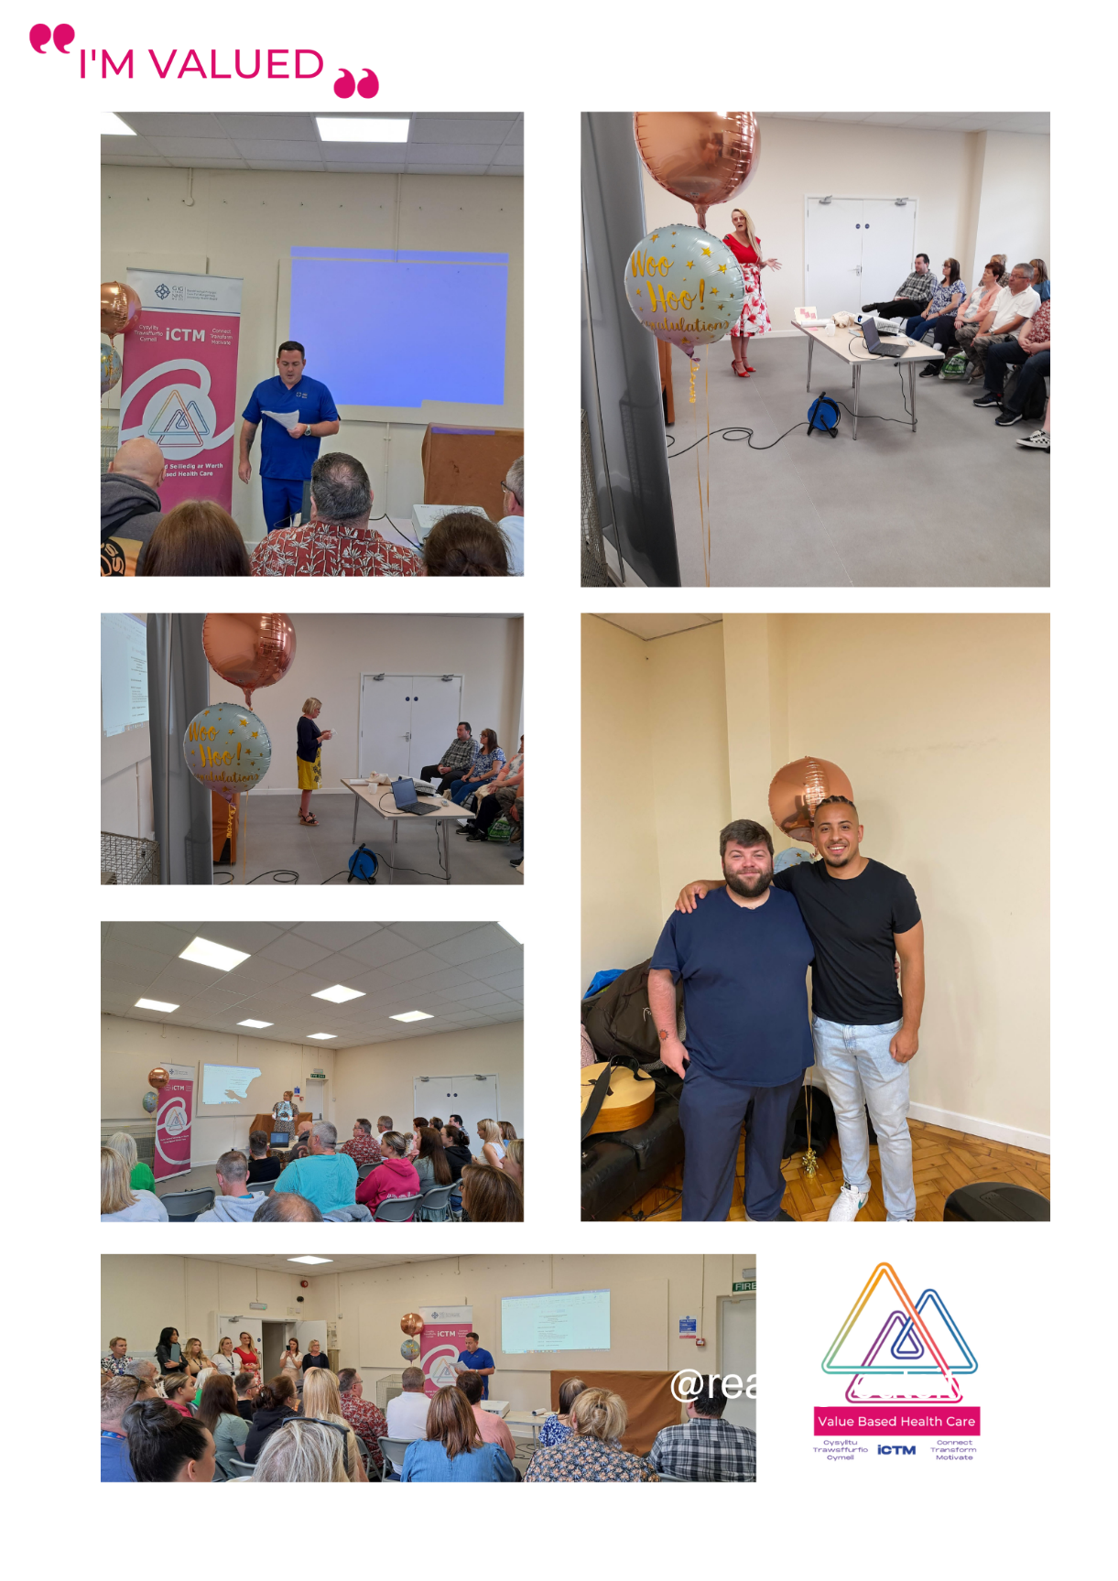
Service User Involvement
Celebration event held on 5th July 2023.
This event including the activities held for Alcohol Awareness Week and the wider work with the SIG has been an excellent example of:
  Parnership working
  Implementing a Patient Centred VBHC approach
  A good example of implementing a VBHC project with partner agencies
This was a fantastic event with clinicians, local authority, Welsh Government, Barod and service users all present.
A launch of the spoken word song was made at this celebratory event.

Slide 10
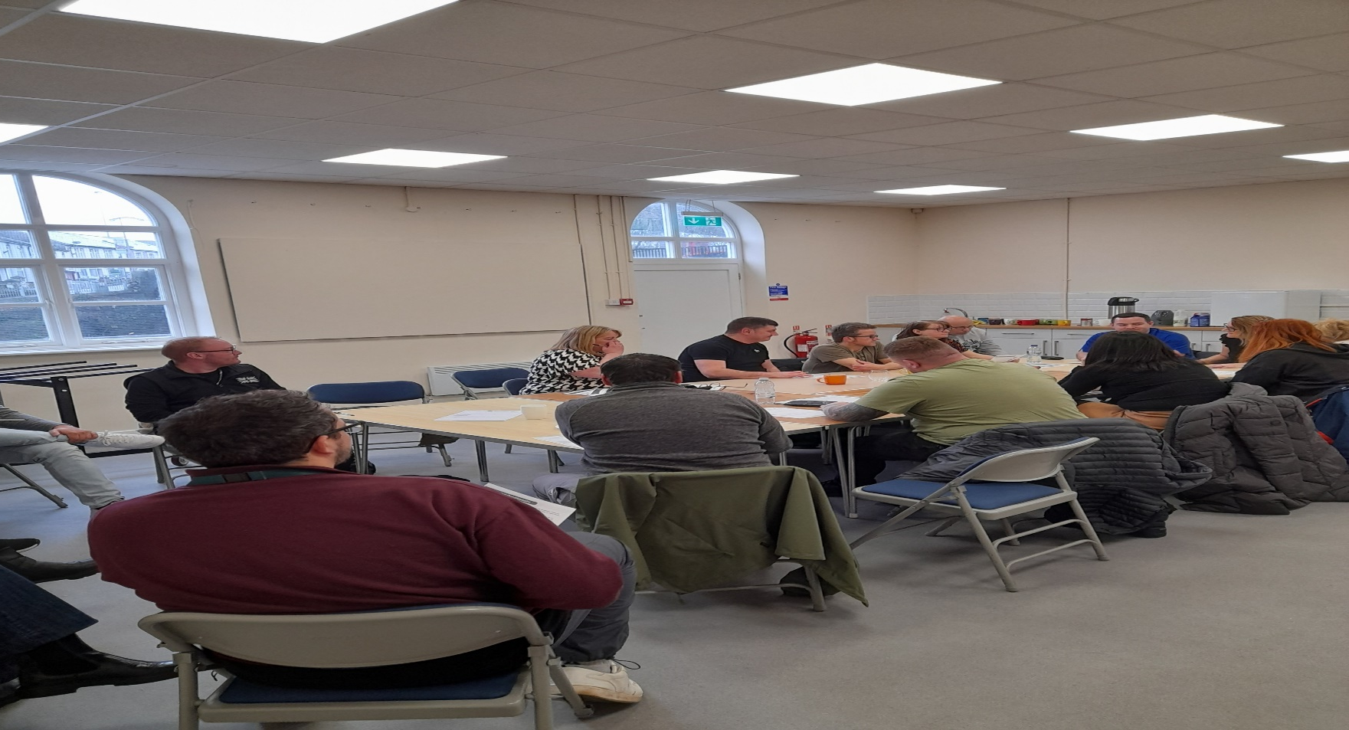
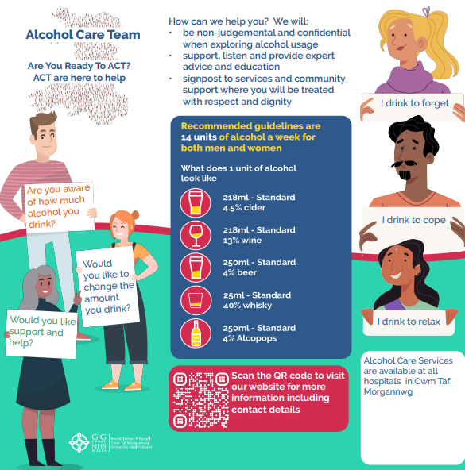
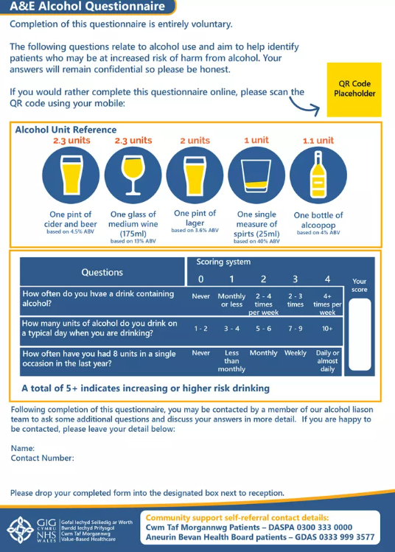
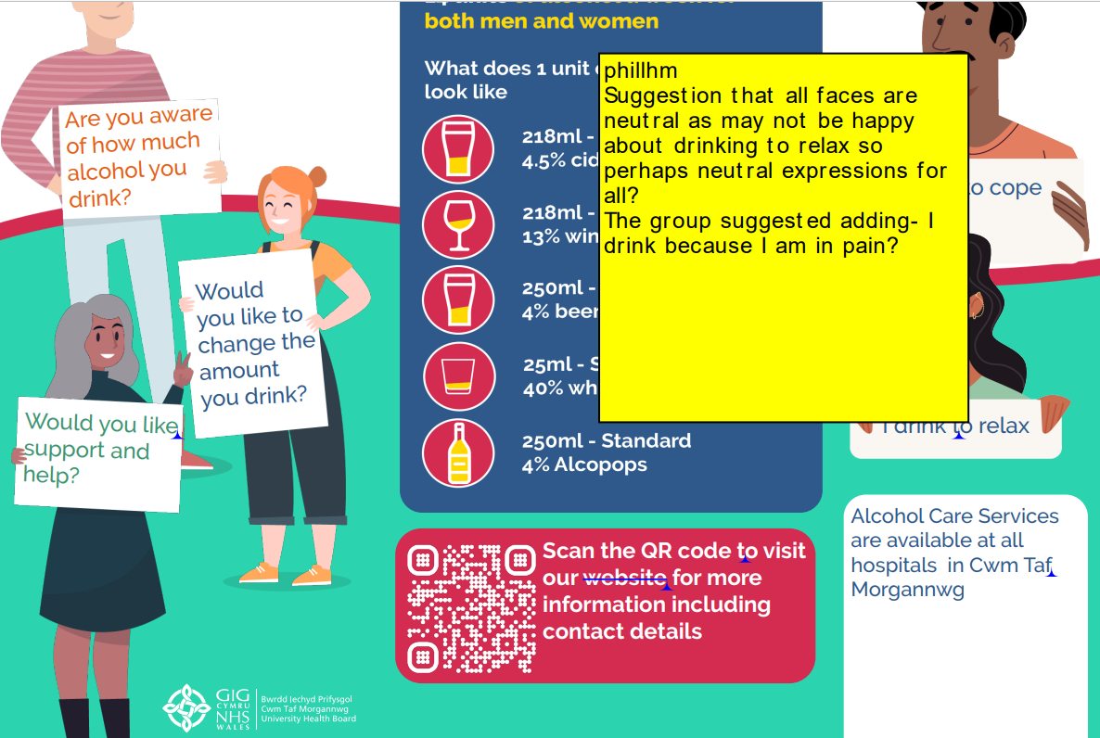
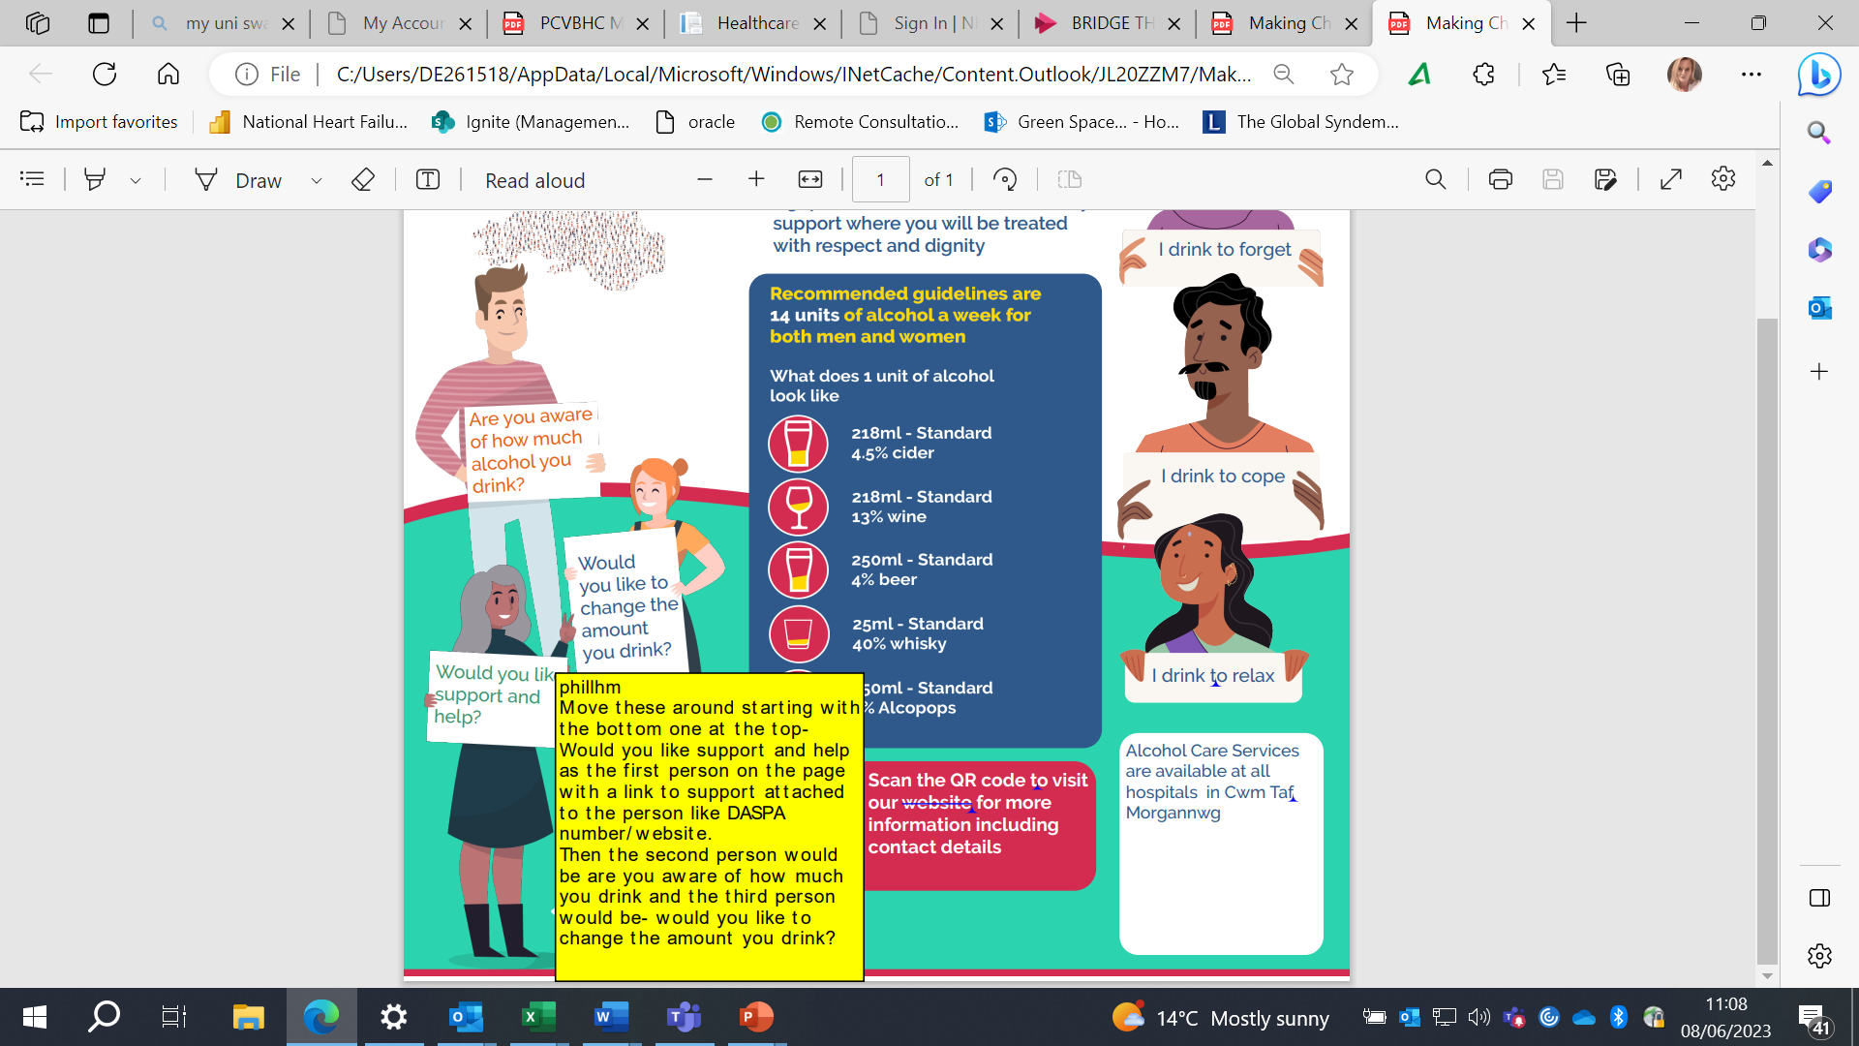
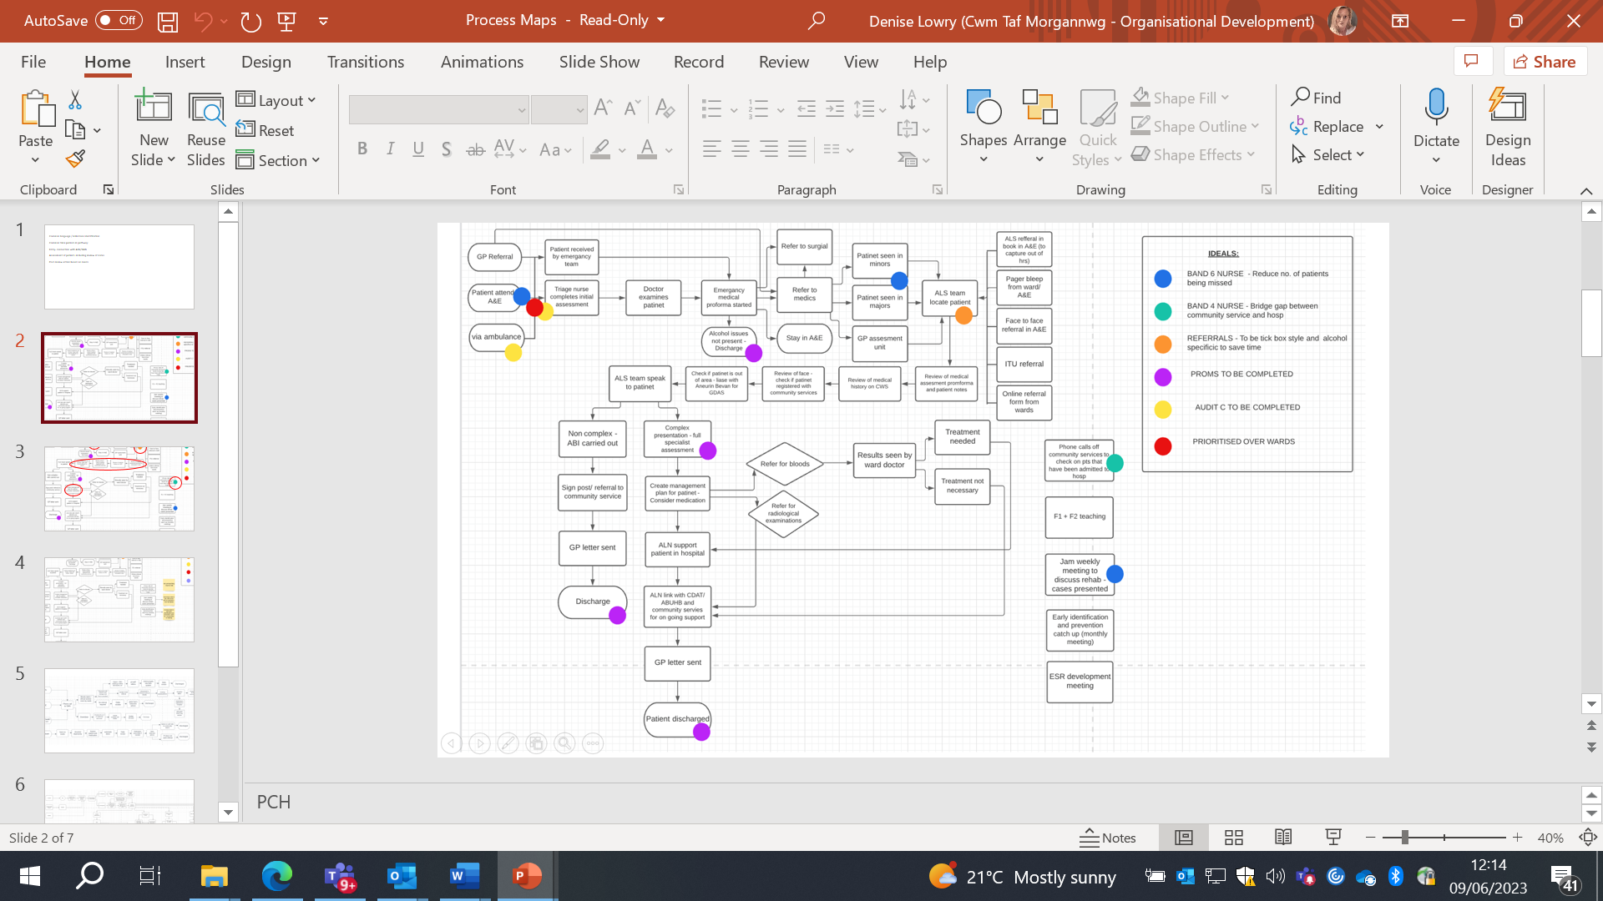
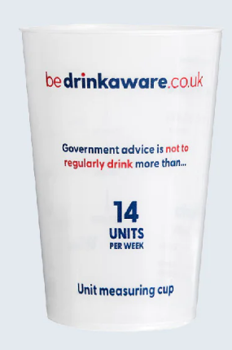
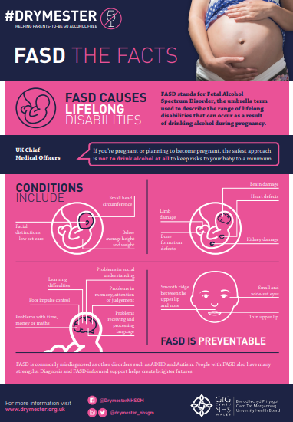
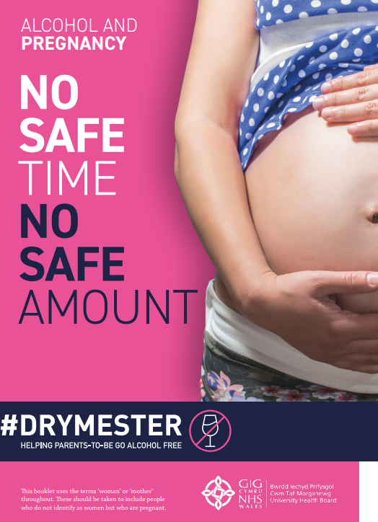
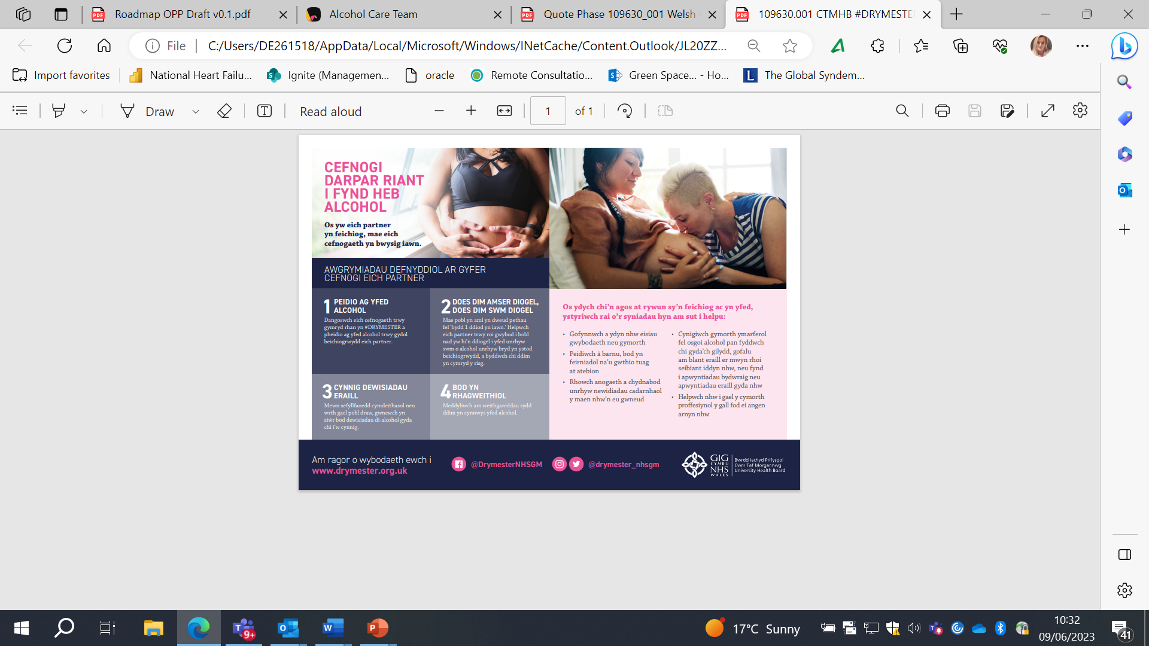
Progress to Date
The group felt it was positive there is a leaflet about the Service and had lots of ideas building on this, including having unit cups available at the hospital for people to take alongside the leaflet as well as DASPA leaflets

Slide 11
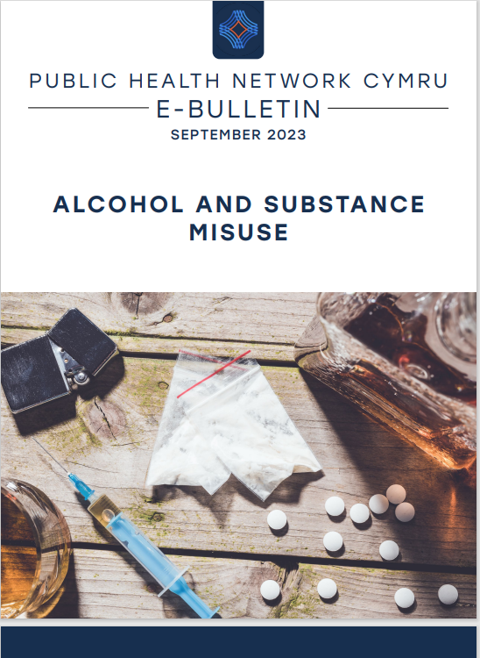
Published Articles
2 articles have been published from CTM in the Public Health Wales Network Bulletin which covers national, regional or local initiatives, policies or programmes aimed at preventing alcohol or substance misuse or improving outcomes for those who are affected by alcohol or substance misuse. The article focusses on us leading the National Patient Information
leaflet development and our work with service users.
Alcohol and Substance Misuse - Public Health Network Cymru

Slide 12

The Public Health Team, Adulthood Strategy Group, VBHC team and colleagues across hepatology, paediatrics and midwifery services have been working together on the prevention agenda for FASD by localising #DRYMESTER- a campaign from Greater Manchester Health & Social Care Partnership which aims to spread the correct guidance about risks of drinking alcohol during pregnancy and to help parents go alcohol free.
27th November was the big day we got to launch #DRYMESTER at CTM which is the first health board in Wales to support the campaign. Please see attached communications and link to the webpage for more information. Watch the videos and scroll down to see the materials available:
#Drymester - Say no to alcohol in pregnancy
Drymester - Cwm Taf Morgannwg University Health Board (nhs.wales)

Slide 13
There were ~4500 births during 2022-23, all patients will have a revised alcohol care assessment and will have evidence in their notes, signposting to Drymester or referred as per the pathway
Already 50% of midwives have had face to face training and a training video has been disseminated to all midwives and obstetricians. This training has been made mandatory for community midwives.
A yearly audit along wit the other public health audits planned for October 24, mini audit planned for March 2024 to assess implementation.
Work will now continue on evaluating the benefits and outcomes from this work.

Slide 14
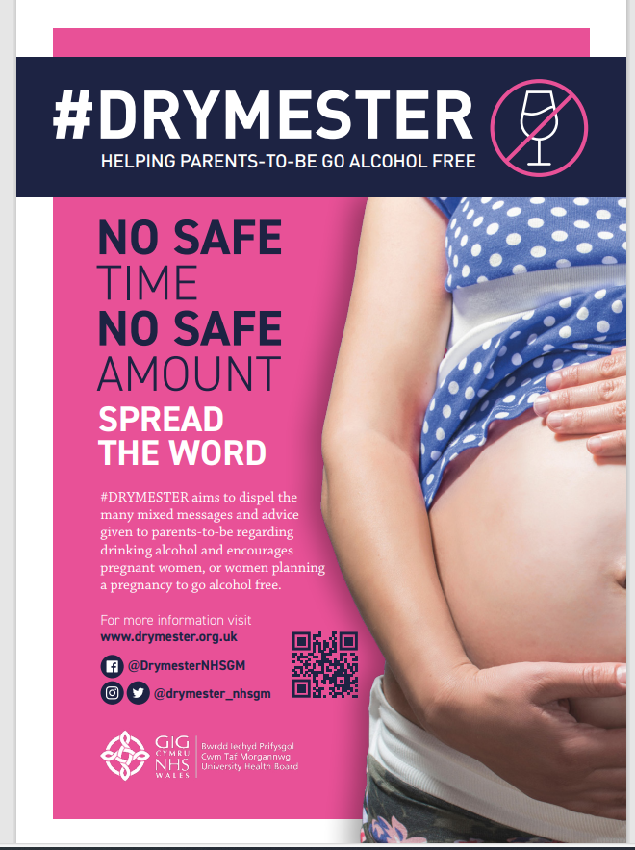
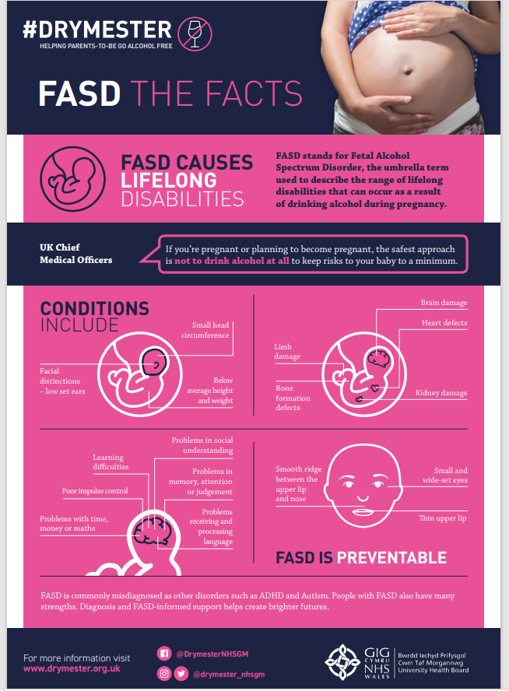
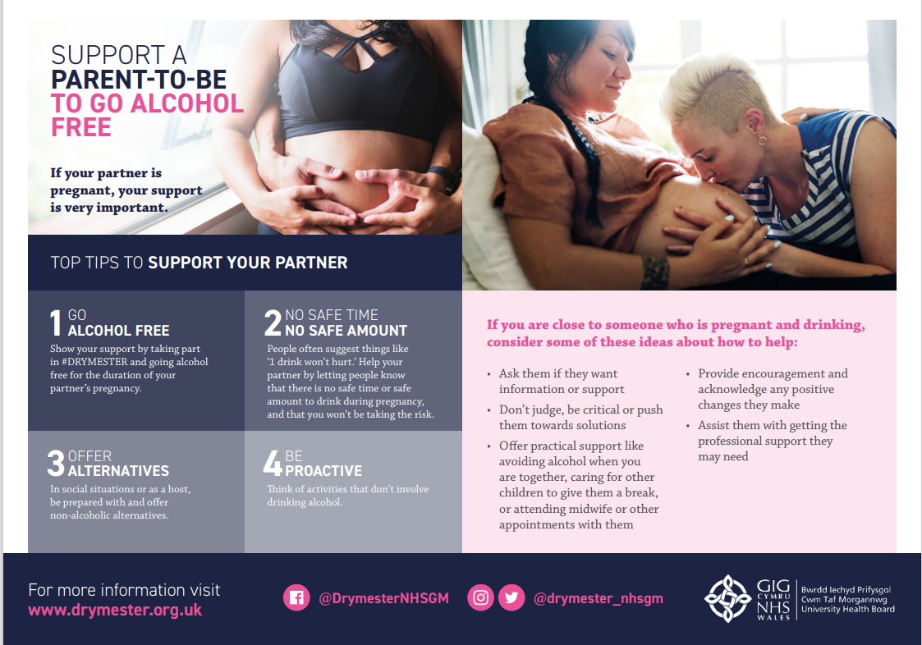
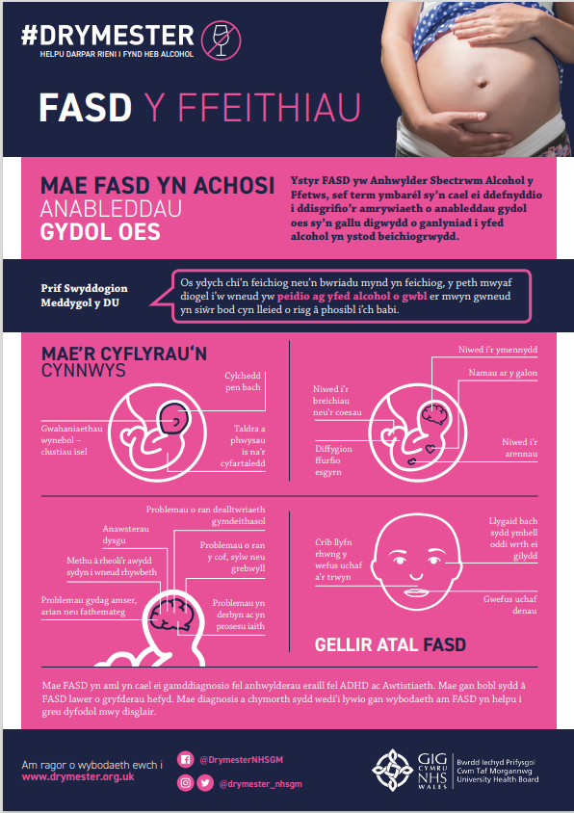
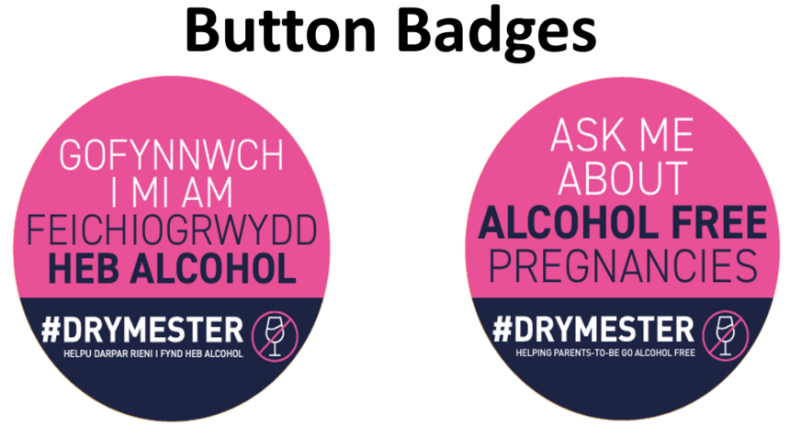
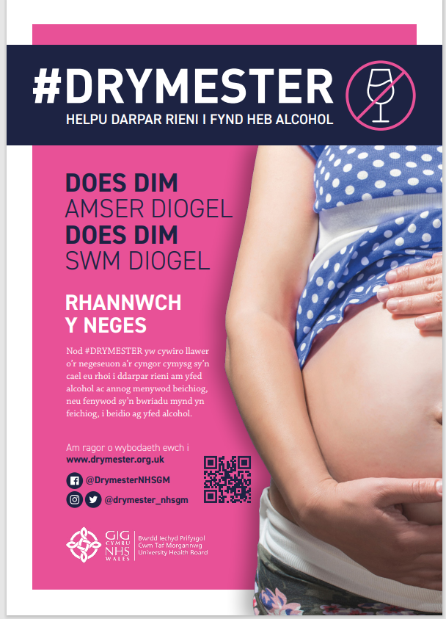
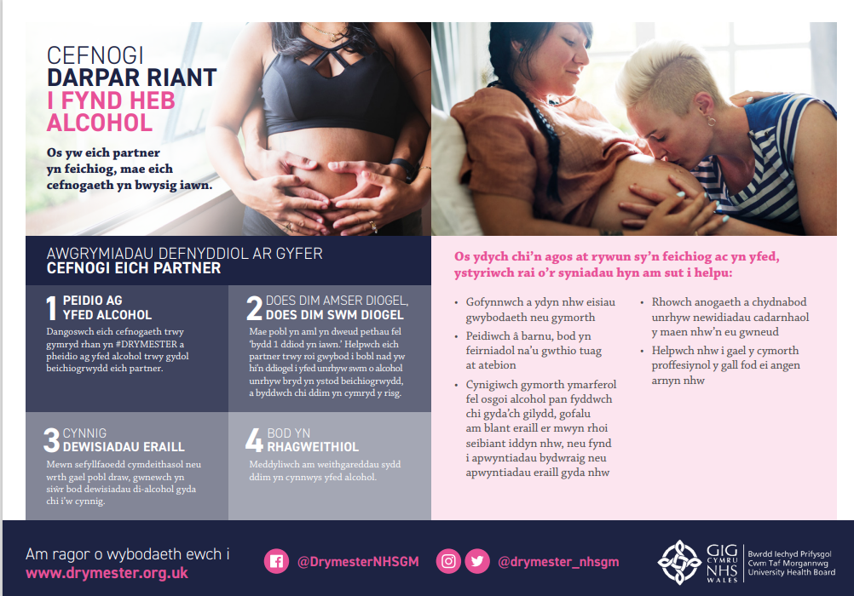
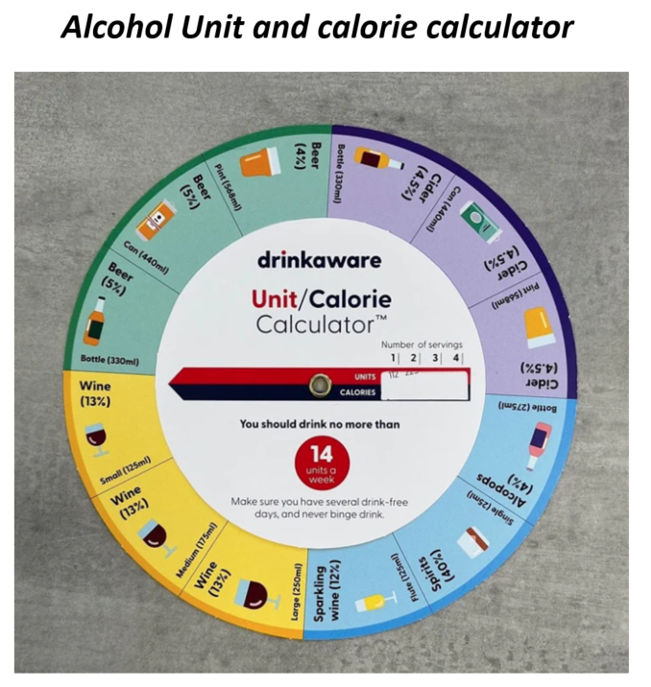
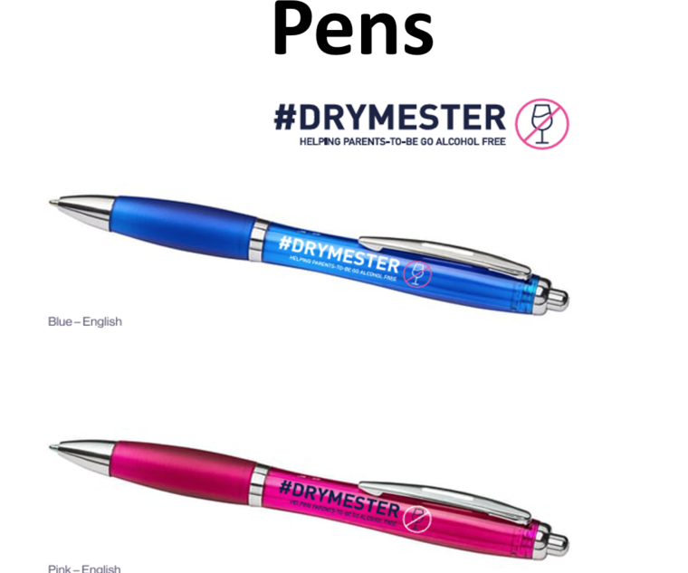
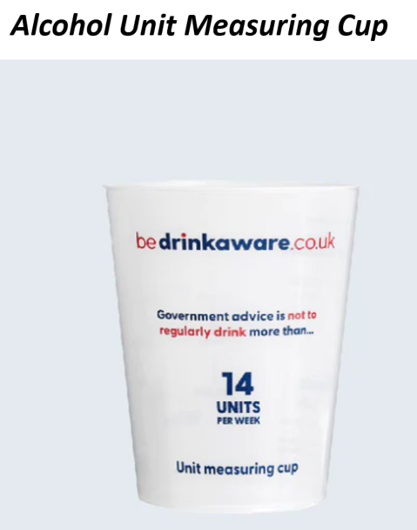
Launch materials

Slide 15

Next Steps for the Project
Roll out of patient information leaflets and A&E questionnaire
Continue to develop and share work with National Liver Implementation Group and beyond to support improvement care delivery across Wales
Develop VBHC Measures (PROM / PREM / WREM) & information flows
Continue to work with Service User Group and partners to
develop goals orientated approaches
Focussed approach with other service areas i.e. T&O, Head & Neck cancer
Continuation of participation in Global Person Centred Approaches To Care Project
Review further research opportunities

Slide 16

Thanks for listening
@cwmtafmorgannwg
FIND US ON

