Slide 1

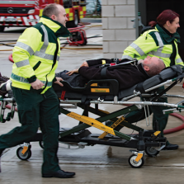

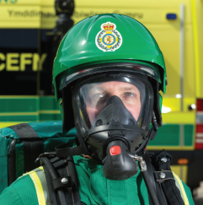
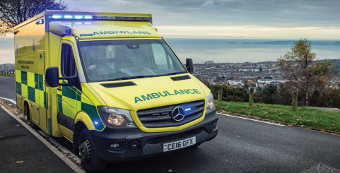

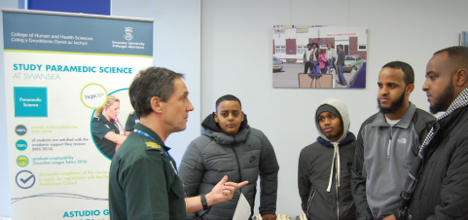
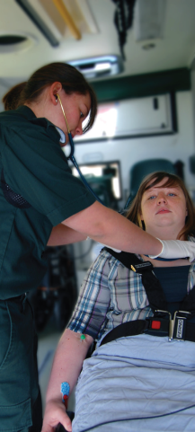
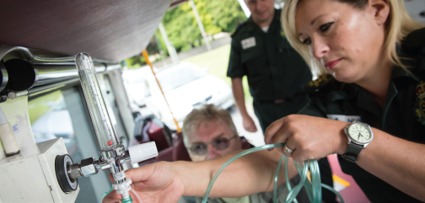
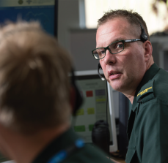


Patient Safety & Experience Highlight Report
Cwm Taf Morgannwg University Health Board
Reporting Period November 2020
welshambulanceservice
@welshambulance
www.ambulance.wales.nhs.uk

Slide 2

Introduction
This Patient Safety and Experience Highlight Report provides an ‘at a glance’ update on the current patient safety and experience landscape within the Welsh Ambulance Services NHS Trust and Cwm Taf Morgannwg University Health Board area. It specifically focusses upon the following key areas:
    Summary
    Secondary Care
    Delayed community responses
    Delayed response impact
    Resource availability
    Joint Investigation Framework – Appendix b
    Regulation 28 and Prevention of Future Deaths
    Adverse media attention
    Patient Experience
www.ambulance.wales.nhs.uk

Slide 3
Summary
We can see from the data presented in the following slides, that following 2,500 handover presentations at Emergency departments within Cwm Taf Morgannwg, 1,254 were outside of the 15 minute notification to handover target time.
In addition to this, 460 patients waited between 1 hour and 10 hours to handover care to Emergency department staff. With an additional 6 patients waiting in excess of 10 hours.
During the month of November, 257 patients awaited a primary response in the community between 6 and 21 hours. From the data contained within slide 6, it can be seen that 198 of these patients were in the Amber 1/2 category. These categories include, chest pain, stroke, dyspnoea, overdose, abdominal pain, allergic reactions, unconsciousness (and fainting). Significantly, the chest pain and stroke patients (if confirmed +ve) would by definition have missed the opportunity for clinical intervention such as PPCI and Thrombolysis.
60 patients ( 5 x Amber1, 40 x Amber2, 4 x Green2, 11 x Green3) waited beyond 12 hours to 21 hours for a community response.
www.ambulance.wales.nhs.uk

Slide 4
Secondary Care
www.ambulance.wales.nhs.uk

Slide 5
Secondary Care
Hospital Health Board | Notification to Handover - Delays by Time Band
 | <15 mins | 15-30 mins | 30-60 mins | 1-2 hrs | 2-3 hrs | 3-4 hrs | 4-5 hrs | 5-6 hrs | 6-7 hrs | 7-8 hrs | 8-9 hrs | 9-10 hrs | >10 hrs | Grand Total
All Health Boards | 5,559 | 4,001 | 2,583 | 1,654 | 750 | 417 | 224 | 122 | 72 | 44 | 27 | 7 | 11 | 15,471
 | 35.9% | 25.9% | 16.7% | 10.7% | 4.8% | 2.7% | 1.4% | 0.8% | 0.5% | 0.3% | 0.2% | 0.0% | 0.1%
Aneurin Bevan | 339 | 414 | 492 | 315 | 148 | 85 | 64 | 36 | 22 | 18 | 5 | 0 | 2 | 1,940
 | 17.5% | 21.3% | 25.4% | 16.2% | 7.6% | 4.4% | 3.3% | 1.9% | 1.1% | 0.9% | 0.3% | 0.0% | 0.1%
Betsi Cadwaladr | 1,243 | 1,254 | 708 | 477 | 247 | 120 | 58 | 17 | 4 | 1 | 0 | 0 | 0 | 4,129
 | 30.1% | 30.4% | 17.1% | 11.6% | 6.0% | 2.9% | 1.4% | 0.4% | 0.1% | 0.0% | 0.0% | 0.0% | 0.0%
Cardiff And Vale | 539 | 616 | 449 | 241 | 50 | 9 | 2 | 1 | 0 | 0 | 0 | 0 | 0 | 1,907
 | 28.3% | 32.3% | 23.5% | 12.6% | 2.6% | 0.5% | 0.1% | 0.1% | 0.0% | 0.0% | 0.0% | 0.0% | 0.0%
Cwm Taf Morgannwg | 1,246 | 509 | 279 | 182 | 90 | 75 | 31 | 28 | 28 | 14 | 9 | 3 | 6 | 2,500
 | 49.8% | 20.4% | 11.2% | 7.3% | 3.6% | 3.0% | 1.2% | 1.1% | 1.1% | 0.6% | 0.4% | 0.1% | 0.2%
Hywel Dda | 1,227 | 587 | 256 | 192 | 90 | 47 | 26 | 8 | 5 | 1 | 3 | 1 | 1 | 2,444
 | 50.2% | 24.0% | 10.5% | 7.9% | 3.7% | 1.9% | 1.1% | 0.3% | 0.2% | 0.0% | 0.1% | 0.0% | 0.0%
Out of Area | 303 | 308 | 140 | 44 | 16 | 1 | 1 | 0 | 0 | 0 | 0 | 0 | 0 | 813
 | 37.3% | 37.9% | 17.2% | 5.4% | 2.0% | 0.1% | 0.1% | 0.0% | 0.0% | 0.0% | 0.0% | 0.0% | 0.0%
Swansea Bay | 662 | 313 | 259 | 203 | 109 | 80 | 42 | 32 | 13 | 10 | 10 | 3 | 2 | 1,738
 | 38.1% | 18.0% | 14.9% | 11.7% | 6.3% | 4.6% | 2.4% | 1.8% | 0.7% | 0.6% | 0.6% | 0.2% | 0.1%
www.ambulance.wales.nhs.uk

Slide 6
Delayed Community Responses
www.ambulance.wales.nhs.uk

Slide 7
Delayed Community Responses
Patient Waits in Hours over 6 Hours - Cwm Taf Morgannwg
Date | 6 | 7 | 8 | 9 | 10 | 11 | 12 | 13 | 14 | 15 | 16 | 17 | 18 | 19 | 20 | 21 | 22 | Grand Total
01/11/2020 |  | 2 | 1 |  | 1 |  |  |  |  |  |  |  |  |  |  |  |  | 4
02/11/2020 | 2 | 1 | 1 | 2 |  | 2 |  |  |  |  |  |  |  |  |  |  |  | 8
03/11/2020 | 2 |  | 3 | 3 | 1 |  | 1 |  |  |  |  |  |  |  |  |  |  | 10
04/11/2020 | 2 | 1 |  |  | 1 |  |  | 1 |  |  |  |  |  |  |  |  |  | 5
05/11/2020 | 1 |  |  |  |  |  |  |  |  |  |  |  |  |  |  |  |  | 1
06/11/2020 |  |  | 1 | 1 | 1 |  |  |  |  |  |  |  |  |  |  |  |  | 3
07/11/2020 | 1 | 2 |  |  | 1 | 1 | 1 |  |  |  |  |  |  |  |  |  |  | 6
08/11/2020 | 1 | 2 |  |  |  |  |  |  |  |  |  |  |  |  |  |  |  | 3
09/11/2020 | 1 | 2 | 1 |  |  | 1 |  |  |  |  |  |  |  |  |  |  |  | 5
10/11/2020 | 2 | 2 |  | 2 | 1 |  |  |  |  |  |  |  |  | 1 |  |  |  | 8
11/11/2020 | 1 |  | 3 | 2 | 2 |  |  |  |  |  |  |  |  |  |  |  |  | 8
12/11/2020 |  | 2 | 1 |  |  |  |  |  |  |  |  |  |  |  |  |  |  | 3
13/11/2020 | 1 | 7 | 1 | 2 |  | 1 | 1 | 1 | 3 | 1 |  |  |  |  |  |  |  | 18
14/11/2020 | 2 | 3 |  | 1 | 1 | 1 |  |  | 1 |  | 2 | 2 | 1 | 2 |  |  |  | 16
15/11/2020 | 4 | 2 |  | 2 |  |  | 1 |  |  |  |  |  |  |  |  |  |  | 9
16/11/2020 | 3 |  | 2 |  |  |  |  | 1 | 1 | 1 | 3 | 1 |  | 1 |  |  |  | 13
17/11/2020 | 3 | 1 |  |  | 1 |  | 1 |  |  |  |  |  | 1 |  |  | 1 |  | 8
18/11/2020 | 3 |  |  |  |  |  |  |  |  |  |  |  |  |  |  |  |  | 3
19/11/2020 | 3 | 2 | 1 | 3 | 1 | 1 | 1 |  |  |  |  |  |  |  |  |  |  | 12
20/11/2020 |  | 2 |  |  |  |  |  |  |  |  |  |  |  |  |  |  |  | 2
21/11/2020 | 4 | 2 | 2 |  | 1 | 2 | 1 | 1 | 1 |  | 1 |  |  |  |  |  |  | 15
22/11/2020 |  | 4 |  |  |  | 2 | 1 |  |  |  |  | 1 |  |  |  |  |  | 8
23/11/2020 | 2 | 2 | 1 | 2 | 1 | 2 | 2 |  |  |  |  |  |  |  |  |  |  | 12
24/11/2020 |  | 2 | 2 | 1 | 1 | 1 |  |  |  |  |  |  | 1 |  |  |  |  | 8
25/11/2020 | 1 | 3 | 2 | 3 | 1 |  |  |  |  |  |  |  |  |  |  |  |  | 10
26/11/2020 | 3 | 2 | 1 | 1 |  |  |  | 1 |  |  |  | 1 |  |  |  |  |  | 9
27/11/2020 | 2 |  | 2 | 1 | 1 | 2 | 1 | 1 | 1 | 2 | 1 |  |  |  |  |  | 1 | 15
28/11/2020 | 1 | 2 |  |  | 1 |  | 1 |  |  | 1 | 1 |  |  |  | 1 |  |  | 8
29/11/2020 | 2 | 3 | 1 | 1 |  | 1 | 1 | 1 |  |  |  |  |  |  |  |  |  | 10
30/11/2020 | 2 | 4 | 1 | 2 | 3 |  | 1 | 2 | 1 |  | 1 |  |  |  |  |  |  | 17
Grand Total | 49 | 55 | 27 | 29 | 20 | 17 | 14 | 9 | 8 | 5 | 9 | 5 | 3 | 4 | 1 | 1 | 1 | 257
www.ambulance.wales.nhs.uk

Slide 8
Delayed Response Impact
www.ambulance.wales.nhs.uk

Slide 9
Delayed Response Impact
www.ambulance.wales.nhs.uk

Slide 10
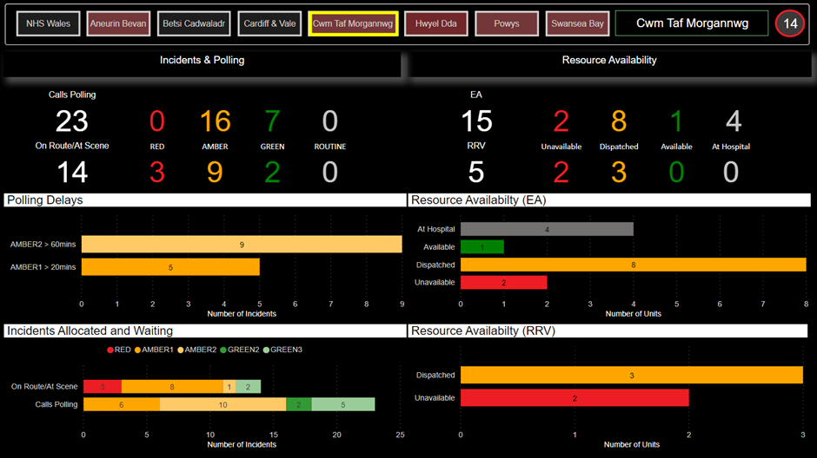
Resource Availability
*Data snapshot 26/11/2020
www.ambulance.wales.nhs.uk

Slide 11
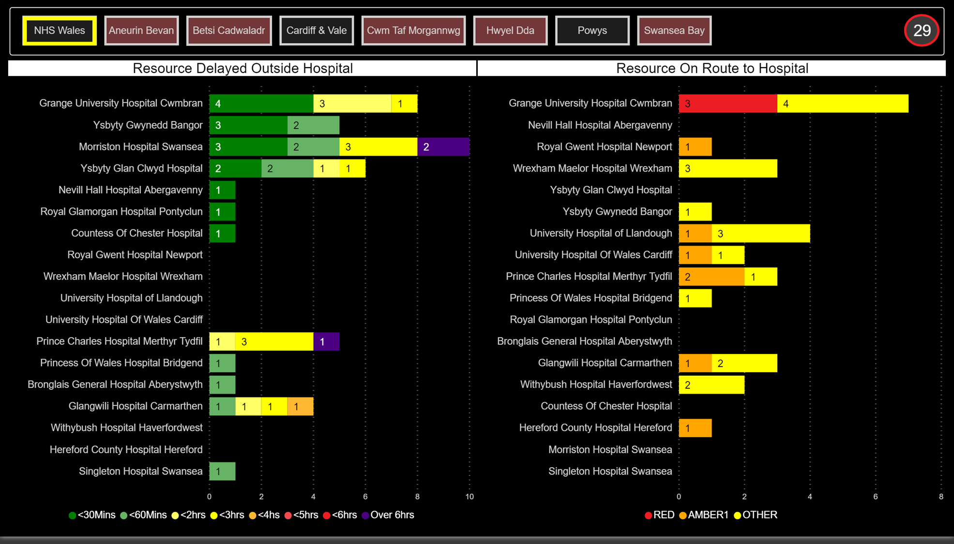
Resource Availability
*Data snapshot 18/11/2020
www.ambulance.wales.nhs.uk

Slide 12
Joint Investigation Framework – Appendix b
Joint Investigation Framework – Appendix b (Source: SCIF)
The Joint Investigation Framework includes all Health Boards and Trusts in Wales, and relates to patient safety incidents escalated by The Welsh Ambulance Services NHS Trust (WAST) that have been considered at the Serious Case Incident Forum (SCIF) and where the primary causal factor relates to or as a consequence of Health Board hospital handover delays.
During November there were four incidents that were reviewed at the SCIF which met the criteria for the appendix b framework.
Delayed response (3.5hrs) to a 66 year old female who was reported as short of breath and feverish. ROLE implemented at scene. Hospital handover delays were a significant factor in our ability to respond sooner.
Delayed response (7.5hrs) to a 79 year old male reported to be Covid+, not eating or drinking, very weak with rapid breathing. Gentleman had a DNR in place and end of life care plan commenced. Hospital handover delays were a significant factor in our ability to respond sooner.
Delayed response (4hrs) to an 89 year old female reported as having difficulty in breathing. Hospital handover delays were a significant factor in our ability to respond sooner.
Delayed response (5hrs) to a 74 year old male reported as Covid+ and experiencing difficulty in breathing. ROLE implemented at scene. Hospital handover delays were a significant factor in our ability to respond sooner.
www.ambulance.wales.nhs.uk

Slide 13
Regulation 28 Prevention of Future Deaths
Regulation 28 (Source: Coroner)
During November the Trust has received no Regulation 28’s in relation to hospital handover delays within the Cwm Taf Morgannwg Health Board Area.
www.ambulance.wales.nhs.uk

Slide 14
Patient Experience
Patient Experience
Feedback from Patient Experience and Community Involvement Team;
No reported negative feedback reported during November
www.ambulance.wales.nhs.uk

Slide 15
Adverse Media Attention
There has been one negative media coverage about WAST in the CTMU Health Board area in November 2020.
BBC, MSN, 19 November – Ryan Bullimore inquest Pontypool fatal mountain bike crash 999 call was 'not a priority' - BBC News
www.ambulance.wales.nhs.uk

