Slide 1







CYNNAL EIN
DYFODOL
YSBRYDOLI
POBL
GWELLA
GOFAL
CREU
IECHYD
Ein Hiechyd
Ein Dyfodol
DATBLYGU CYMUNEDAU
IACHACH GYDA’N GILYDD
(Agenda Item) | 30/07/2025 | Public Board | From Children's to Adult Care Services: a family’s reflections
Report Details:
FOI Status: | Please select: Open (Public)
If closed please indicate reason:
Prepared By: If you do not wish for your name to be included in the public domain, please only include your job title | Head of Peoples Experience Communication Team Patient Care & Safety Team
Presented By: If you do not wish for your name to be included in the public domain, please only include your job title | Dr Dom Hurford and Dr Gareth Roberts
Approving Executive Sponsor: | Dr Dom Hurford (EMD)
Report Purpose | Please Select: For Discussion For Noting
Engagement undertaken to date:
Impact Assessment:
Indicate the Quality / Safety / Patient Experience Implications: | Outline of positive experiences and challenges in care.
Related Health and Care Standard
Equality and Welsh Language Have you undertaken an Equality and Welsh Language Impact Assessment Screening? | No
Are there any Legal Implications /Impact. | No
Are there any resource (capital/Revenue/Workforce Implications / Impact? | No
Link to Strategic Goals | Please Select: Improving Care Creating Health

Slide 2
From Children's to Adult Care: a family’s reflections.
Introduced by the Executive Medical Director
Why this story matters
What the Board should consider when hearing the family’s feedback

Slide 3
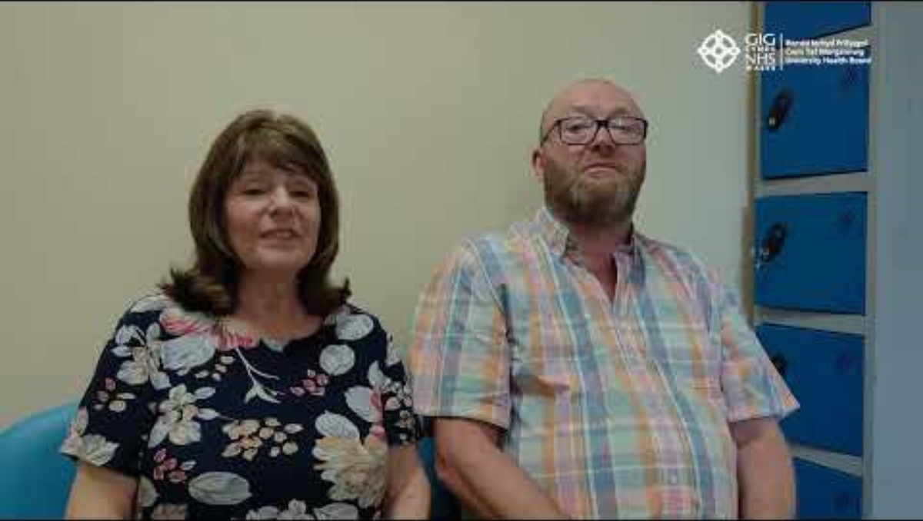

Slide 4
From Children's to Adult Care: a family’s reflections.
Reflections by the team and the Executive Medical Director
A Consultant’s view – Gareth Roberts
Our Executive Medical Director’s reflections:
What are the challenges facing children who are transitioning from children to adult services?
What are we currently doing in CTM to better inform our approach?

