Slide 1

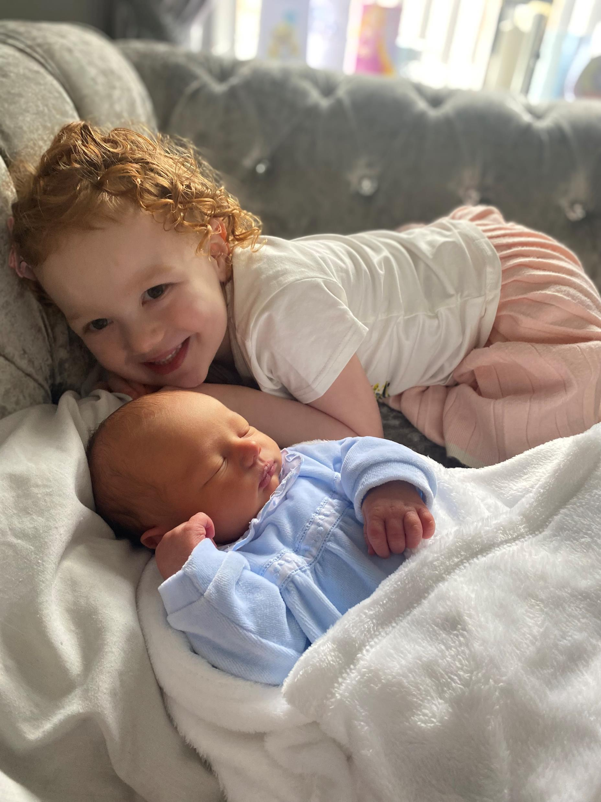

Elijah and his family’s story
Communication/language – Health Board Values
Compassion/kindness
Concerns dismissed and feeling humiliated
Mothers ‘gut instinct’
Dismissing mother’s concerns
Bereavement support
Share story with staff involved
Discussion with maternity colleagues
Discussion with patient safety re length of time of reports
Share with primary care
Patients notes – ‘deceased tape’

