Slide 1

Chief Executive’s Report
March 2020

Slide 2
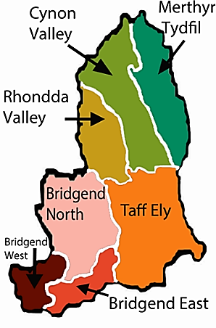
Contents
Learning
Headlines
Diary Highlights
Looking outwards
Looking ahead

Slide 3
Learning
External Reports received in period:
Using these reports to identify themes to reflect in our improvement and development programmes is progressing well: Always asking “how do we know our services are high quality and safe”.
HIW Unannounced Mental Health Hospital Inspection – Ysbyty Cwm Cynon, Ward 7 (January 2020) - Immediate improvement plan in place, proving HIW sufficient assurance. Awaiting final report.
HIW National Review of Maternity Services – National site inspections (phase 1) complete, moving to reviewing governance arrangements across Wales, including CTM, through a range of interviews (phase 2). Interviews in CTM to commence in early May ‘20.
Second IMSOP Report – the Health Board has made good progress during October, November and December and the Panel is now cautiously optimistic that longer-term sustainable improvement in maternity services at Prince Charles and Royal Glamorgan Hospitals will be delivered.
Management Board Learning Items:
A learning item agenda has been included to start Management Board meetings, to enhance the process of creating, retaining, and transferring knowledge within an organization. Learning at Management Board is encouraged from successes, failures, transformation and improvement work. Two areas have been considered to date:
HIW/WAO Review of Quality Governance learning reflections – Vital to ensure a culture that supports open and informed debate on issues relating to the quality and safety of patient care.
Staff Flu Immunisation Uptake 2019/20 – Visible leadership and modelling of desired behaviours are important.

Slide 4
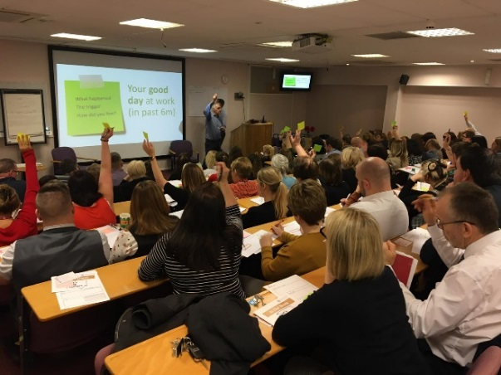
Learning
Let’s Talk with staff – Weekly Pay – The Collaborative Bank Partnership
In January 2020 the Let’s talk with staff sessions highlighted the need to review how we run bank and the need for change and improvement.
From late April 2020, the Health Board will be offering weekly pay to all Registered Nurses, who are employed (either substantively or via a local bank), through a Collaborative Bank model, which will be hosted by Shared Services. The Collaborative Bank means that shifts will be shared between Swansea Bay and Cwm Taf Morgannwg via a Cloud based, MeApp Rostering system, with the overall benefit of increased fill rates through the Bank, resulting in less reliance on agency workers.
The plan is to test the collaborative arrangement for 3 months, with a view to widening the arrangement to other staff groups. Both Health Boards have had engagement events during March 2020 to provide information on how to join and the benefits.

Slide 5
Headlines
Coronavirus (COVID-19) – COVID-19 is a rapidly moving situation. Intensive work has gone into COVID-19 planning over the past month, and we must recognise the huge effort and commitment our staff are putting into dealing with the pandemic. We are continuously monitoring all plans in light of the changing situation and we will adjust or prioritise any corporate plans accordingly. In preparation non-essential activity is being stood down as the capacity required for dealing with COVID-19 increases.
All our teams are working exceptionally hard to ensure we have robust clinical pathways and measures in place across all of our operational areas for managing the COVID-19 pandemic. Work to respond to the COVID-19 pandemic will be covered in more detail in the Coronavirus Board update.
We are in daily contact with our communities; providing the latest information as it becomes available to us (in line with national guidance from Public Health Wales and Government). These updates are widely accessible via all of our Cwm Taf Morgannwg digital channels (social media pages and public website) - https://cwmtafmorgannwg.wales/latest-information-on-novel-coronavirus-covid-19/
A&E Services (South Wales Programme) – To facilitate the response to COVID-19, we are temporarily pausing most activities relating to considering the future of emergency medicine (A&E) and other related services at the Royal Glamorgan Hospital. Some background work will continue where possible.

Slide 6
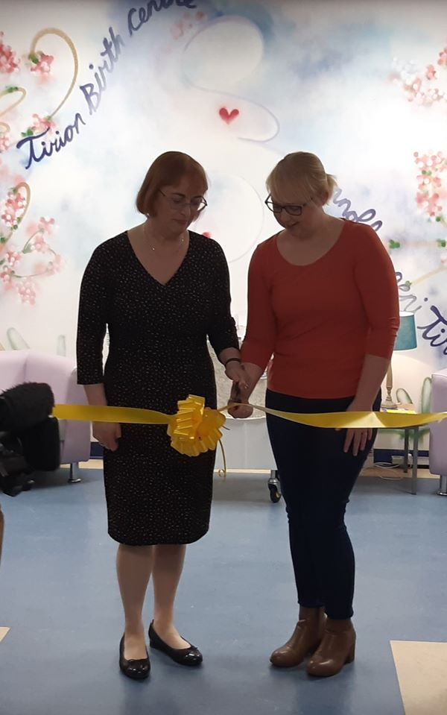
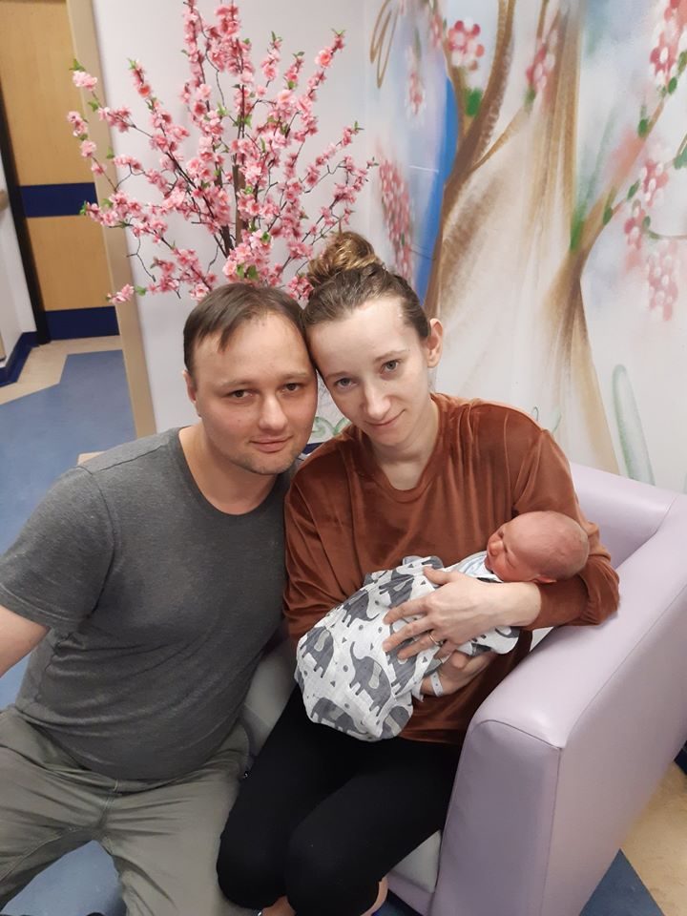
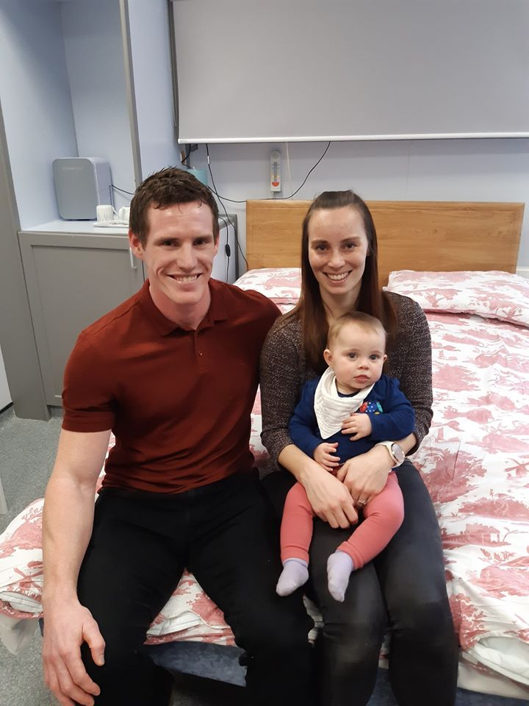
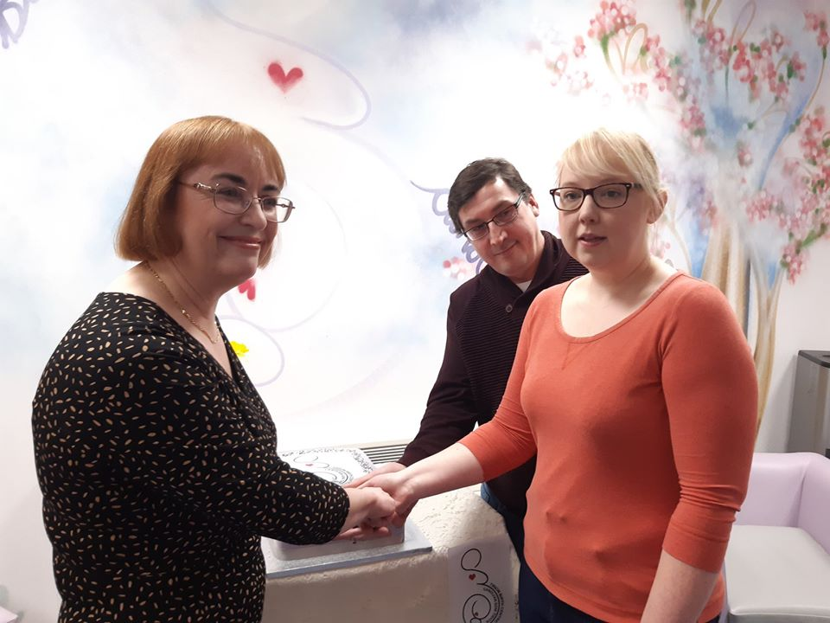
Headlines
The Tirion Birth Centre – The Tirion Birth Centre in the Royal Glamorgan Hospital was officially opened on 9 March 2020 by Wales’ Chief Nursing Officer, Professor Jean White. The event saw the return of parents and their children who had used the birthing centre over the previous year, to celebrate its official opening.
The Birth Centre environment is excellent with access to a birthing pool, and comfortable facilities where both parents can stay together for the duration of the birth. The Centre has been operational since 9 March 2019, and it was fantastic to hear such positive feedback from Mothers and families on their experiences at Tirion.

Slide 7

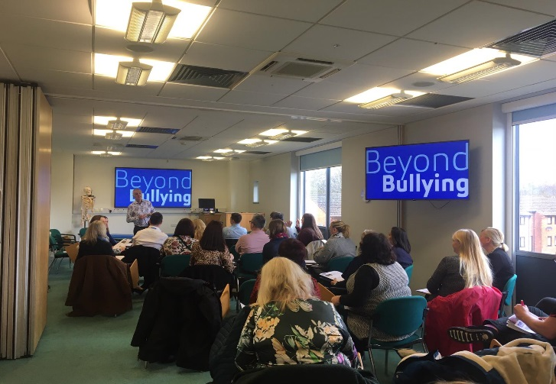
Headlines
Let’s Talk Culture Feedback – The latest phase of Let’s Talk Culture (Feb-March 2020) has seen more than 300 staff participate in feedback sessions and an associated online survey. During this period we presented the insights from phase 1 (Listening Oct – Nov 2019). We invited staff to share their thoughts and views on our first draft values and associated behaviours. Refinement of the draft values and behaviours is now underway before they are finalised.
During this period, we have also held co-creation workshops focused on some key areas including values based recruitment and de-escalating and resolving incidences of poor behaviours. How we embed our new values into our everyday working practices is incredibly important, our collaborative workshop on this provided very rich discussion to inform our approach.

Slide 8
Headlines
Welsh Government escalation and intervention arrangements – Following the tripartite meeting (WG, WAO, HIW) which took place in December 2019, to discuss Cwm Taf Morgannwg’s escalation status, confirmation was received that our escalation status remains unchanged (at special measures for maternity services and targeted intervention (TI) for quality and governance). Good progress continues to be made, however, we recognise the serious nature of our situation and the issues we are dealing with. Three maturity matrices have been developed to cover Leadership and Culture, Trust and Confidence, and Quality and Governance. The initial self-assessment against these matrices took place in February 2020 and were discussed with Welsh Government in the Escalation Meeting on the 28 February. The maturity matrix will provide the mechanism through which the Organisation will receive assurance on progress of the TI programme overall.
Development of our Operating Model – Implementation of the Operating Model is well on track to go live from the 1st April. All but one of the senior posts in the top tier of the locality have been filled, joint on-boarding and planning sessions have taken place across all three locality teams. The newly appointed leaders have been instrumental in ensuring the next layer of management is in place for April. Governance frameworks including risk management, performance management and Integrated Locality Group Terms of Reference are being adopted. System Director interviews are taking place in March. Organisation Development support is being identified as part of the mobilisation with a dedicated session for Executives & the Locality directors in April/May. All newly appointed leaders are taking an active role in the Values and Behaviours development. Scheme of Delegation is being updated with a non-financial decision making framework in progress.

Slide 9
Headlines
 | Health Board Wide | Bridgend | Rhondda and Taff | Merthyr and Cynon
Director of Clinical Services Operations | Alan Lawrie
Interim Director of Planning and Performance | Clare Williams
Director of Primary Care and Mental Health | Julie Denley
Director of Acute Services | Kath McGrath
Deputy Director of Nursing | Debbie Bennion
Integrated Locality Group Director |  | Dr Anthony Gibson | Dr Stuart Hackwell | Dr Sarah Spencer
Locality Director of Operations |  | Vacant – being covered by Kath McGrath | Rachel Burton | Adele Gittoes
Locality Director of Nursing |  | Ana Llewellyn | Vacant | Lesley Lewis
New Appointments:

Slide 10
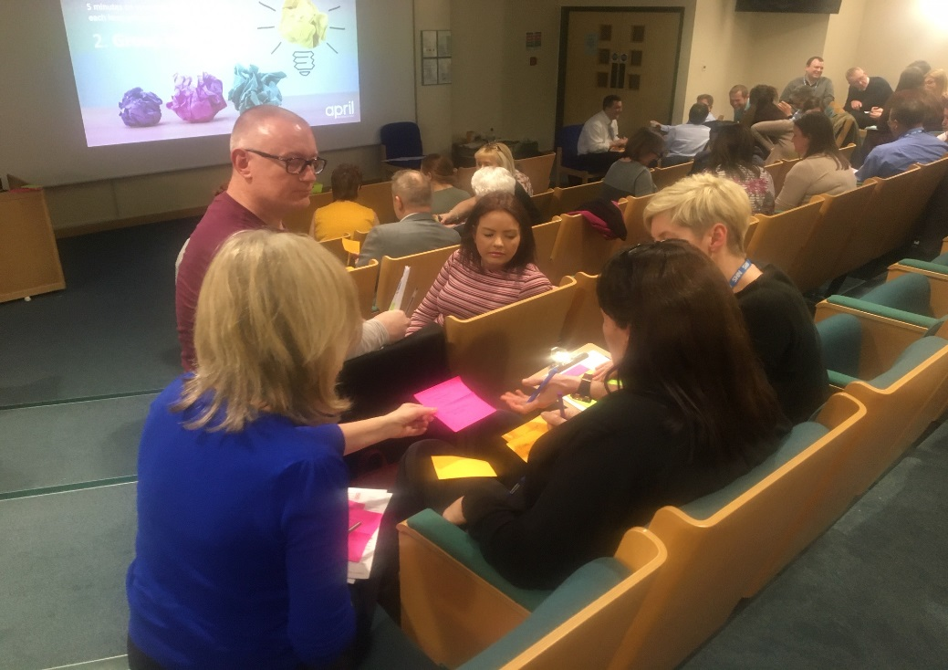
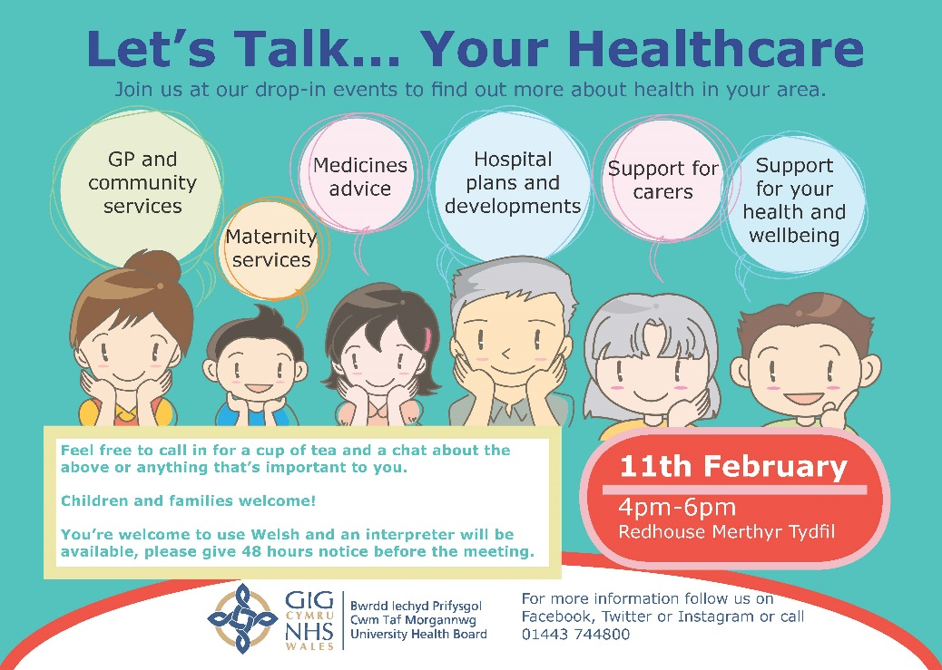
Headlines
Staff Engagement meetings – Regular staff engagement has been taking place under the Let’s Talk programme:
    Let’s Talk…with the Execs sessions have been taking place across CTM sites at different times and locations
    The sessions have been an opportunity for staff to put forward questions, ideas and any concerns they might have
    Staff engagement sessions on proposals for the Emergency Department at RGH have also been taking place across the sites, with many people bringing forward ideas and suggestions about proposals
    Attendance has varied depending on times and locations and we will be evaluating what has worked and what hasn’t
    An ‘all staff’ survey has been launched to ask staff how they would like to be engaged and communicated with
Your Healthcare events – public engagement events have been rolled out during February and March 2020 across the CTM footprint.

Slide 11
Diary Highlights
Welsh NHS Confederation Annual Conference
Attended Rhondda Cynon Taff CBC Council Meeting
Let’s Talk Public Engagement events – Llantrisant Leisure Centre, Red House Merthyr
Staff engagement events – Prince Charles, Royal Glamorgan and Princess of Wales Hospitals
Weekly Staff Drop In Sessions in Royal Glamorgan Hospital
Executive Team Away Day
Met with Medical Staff Committee and Royal Glamorgan Hospital engagement
All Wales Diabetes Implementation Group
Walkabout with Jim Hehir on Ward 10, Princess of Wales Hospital
Attended Public Service Board meeting
Met with people who had raised concerns through UHB concerns process
Meeting with UNISON
Attended Health Social Care and Sports Committee
Attended South Central East Regional Planning and Delivery Forum
Monthly performance meetings with Directorates
Met with Internal Auditors
Executive welcome at Corporate Induction
EASC Meeting
WHSSC Meeting
Regional Partnership Board
Facebook Question & Answer session

Slide 12
Looking Outwards
The Consultation Institute session – An Executive Briefing was provided by the Consultation Institute (tCI) on the 10 February to CTMUHB Executives and wider staff. The session was to explore best practice in consultation, public involvement and impact assessment. Further work with tCI is planned over the coming months to ensure our ongoing commitment to improving stakeholder engagement and involvement is realised and sustained.
The Rapid Diagnostic Clinic (RDC) – The Rapid Diagnostic Clinic concept aims to provide rapid access to a range of diagnostic tests in one location. The RCD was established in July 2017. Prior to the establishment of the RDC, patients who presented at their GP with vague symptoms often experienced lengthy diagnostic pathways before receiving a diagnosis. The Health Board received funding from the Wales Cancer Network (WCN) to pilot this service model in 2017/18 and 2018/19, on behalf of NHS Wales. In 2019/20, the WCN provided part funding with the expectation of match funding from the Health Board. External funding for the service will cease in March 2020. We are working with partners to develop a case for embedding the RDC within the Health Board as a mainstream service.

Slide 13
Looking Ahead
Responding to COVID-19
CTMUHB Integrated Health and Care Strategy – further work to agree our long term strategy.
Maternity Assurance Metrics – Joint workshop with IMSOP planned on 9 March 2020 to further develop the performance framework and agree key metrics that align with the National Maternity and Neonatal Network work programme.
New Operating Model Next Steps
    Operating Model Go-Live 01/4/20
    Supporting framework embedded 01/04/20 – 30/06/20
    Systems Groups Mobilised 30/5/20
    Close Project 30/6/20
    Learning and improvement 01/06/20 – 30/9/20

