Slide 1

Maternity Improvement:
Six Months On
Presentation to Board

Slide 2
Background
Early 2018
Concerns raised about quality and safety of maternity services – internal review commissioned.
Sept 2018
RCOG commissioned by former CTUHB to undertake independent review and internal MIB established
Jan 2019
RCOG/RCM field visit identified serious safety concerns resulting in issuing of interim recommendations
30 April 2019
RCOG/RCM Review published. Minister announced package of interventions
Oct 2018
WG assumed commission of RCOG/RCM review and escalated monitoring
KEY:
RCOG – Royal College of Obstetricians and Gynaecologists and Royal College of Midwives (RCM)
WG – Welsh Government
MIB – Maternity Improvement Board

Slide 3
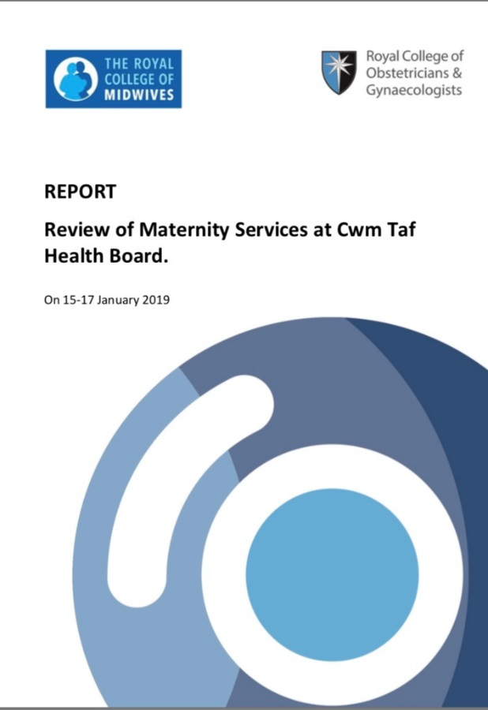
Publication of Reports April 2019
Key concerns across a range of issues:
Governance
Quality and Safety
Staff Experience, Engagement
Staff Capability and Capacity
Management and Leadership
Women’s and Families’ Experience

Slide 4
Special Measures
The Health Minister appoints an Independent Maternity Oversight Panel to:
To provide assurance, constructive challenge and oversight of the improvement against the 70 RCOG/RCM recommendations
To establish and agree an independent multidisciplinary process to clinically review relevant cases and to ensure that any learning which emerges from these reviews is acted upon by the Health Board and others

Slide 5
Maternity Improvement Programme Structure

Slide 6
Driving improvement through a maturity matrix
Basic Level
Early Progress
Results
Maturity
Exemplar
Narrative Descriptions of a Maternity Service at each Level

Slide 7

How are we doing?
Immediate Actions:
Consultant availability for labour ward
Consultant handovers reduced from 4 to 2 per 24 hours
Support for trainees
Out of hours Consultants available within 30 minutes
Induction for locums
Admission criteria for neonates >32 weeks
High risk ante-natal clinic led by Consultant with specialist skills
Midwifery staffing levels monitored with acuity tool and escalation process in place
Governance structure developed
Staff support from senior management and work commenced to improve culture

Slide 8
Safe and Effective Care – evidencing early progress
Governance Framework in place with midwifery and Consultant leads for key elements
Programme of updating all clinical guidelines
Increased audit activity
Full multi-disciplinary engagement
Sharing learning including women and family stories
Still experiencing delays in providing timely responses to complaints - in the context of increasing number of complaints following the publication of the report
Improvement Cymru commitment for large programme of work to build Quality Improvement Capability and to focus on reducing the Induction of Labour rates
Weekly monitoring of maternity dashboard

Slide 9
Quality of Management and Leadership – evidence of early progress
New Maternity Service Leadership team largely in place: new Clinical Director and new Directorate Manager in post. Director of Midwifery to commence in January 2020
Recruitment of three new Consultants Obstetrician and Gynaecologists, Consultant Midwife, Deputy Head of Midwifery, Intra-partum Lead Midwife for the directorate and 7 newly registered midwives at Prince Charles Hospital.
Staffing externally reviewed by Birthrate+ and reported in October
Training programme developed and improving compliance
External providers sourced to work on leadership training and improved culture. Two programmes commenced on 14th November 2019: one for senior leadership team and one for all staff.
‘Let’s Talk’ health board programme
Sickness rates remain high – HR support in place
Organisational Psychologist appointed for CTM –
Maternity Services will be first area of focus
‘Our PDR’s now have meaningful content’
‘It feels really different now’

Slide 10
Quality of Women’s and Families’ Experience – evidence of early progress
Women’s Experience Midwife appointed
Community Engagement events in Merthyr Tydfil, Llantrisant and Bridgend
Lay chair for ‘My Maternity, My Way’
Engagement through dedicated Facebook page
Twice weekly real time feedback from women at Prince Charles Hospital indicating significant improvements in experience
Women and families are continuing to tell us that they are unhappy with the
complaints delays and communication. Increasing
capacity in the governance team to address this.
‘Staff have been helpful, friendly and brilliant’’
I had been dreading to come to PCH. However, everyone has been great ’

Slide 11
What are other people saying about us?
Minister/Independent Maternity Services Oversight Panel - IMSOP’s first quarterly report published on 8th October:
    Better understanding of the problem and underlying causes
    The Health Board has recognised that there are broader, deeper organisational issues
    Foundations for improvement largely in place
    Reasonable assurance about the eleven ‘make safe’ recommendations
    The reconfiguration of services has been achieved without obvious negative consequence

Slide 12
What are other people saying about us?
Community Health Council report August 2019 of 3 unannounced visits to PCH in June and July 2019 – women reporting generally good experience of care but mixed picture in terms of staff morale.
Healthcare Inspectorate Wales inspections of RGH September 2019 – teams congratulated for significant improvements to staff morale, culture, environment and women’s experience
Health Education and Improvement Wales October 2019 – a really positive training experience for medical trainees. ‘Teaching was described as brilliant.’

Slide 13
Next steps…
Turning the dial on the recommendations that have been completed
Working on sustaining improvement on themes from women at Prince Charles Hospital – timely analgesia
Improving complaint response times and experience.
Improvement plan focussing on moving from ‘early progress’ through to ‘results’ phase in the maturity matrix
Focus on working in partnership with staff, women and families and other stakeholders to drive sustained improvement
Improvement through the lens of Values and Behaviours
Aligning key metrics to the projects

